Slide 1
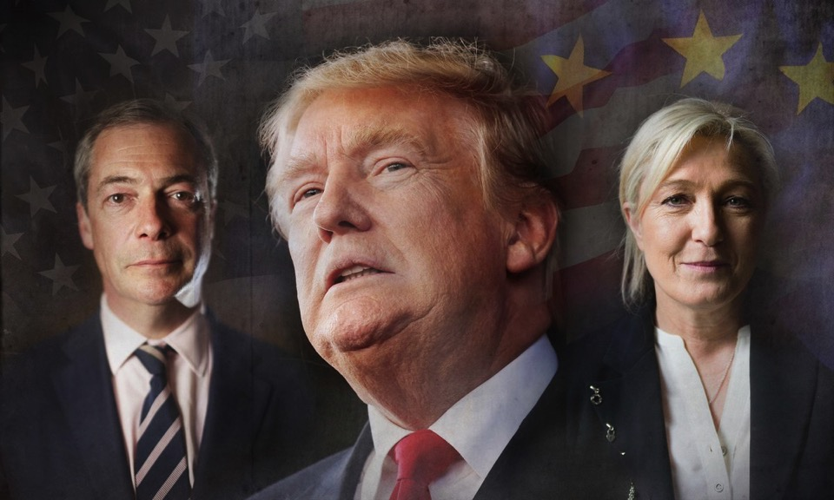
Trump, Populism, and the Politics of Resentment
Bart Bonikowski, Harvard University May 3, 2018, UD

Slide 2
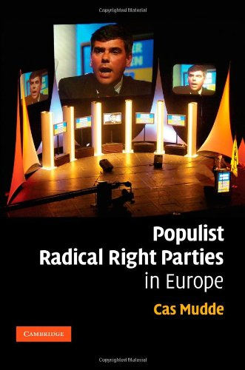
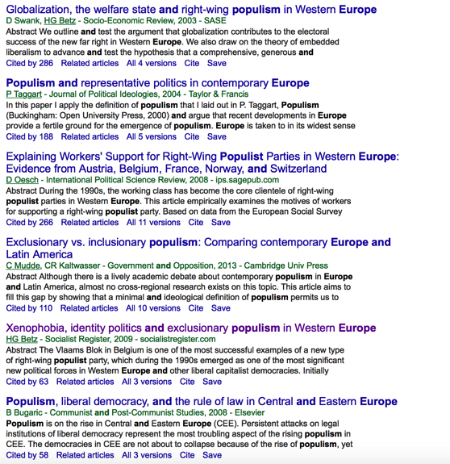
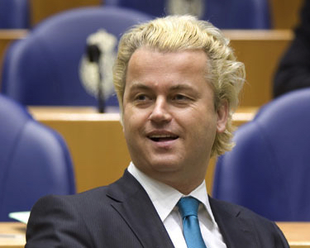
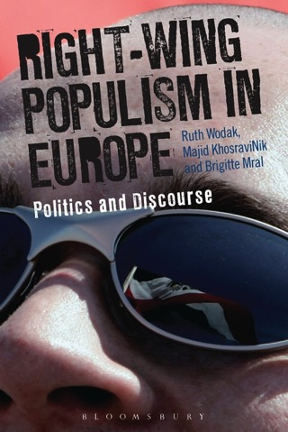
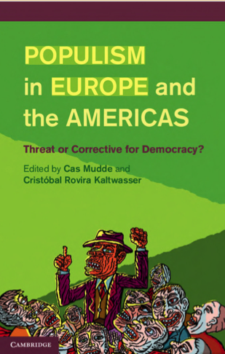
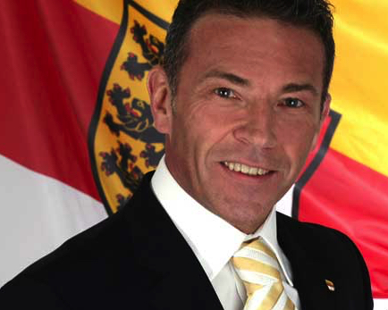
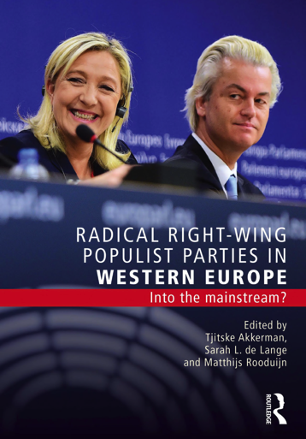
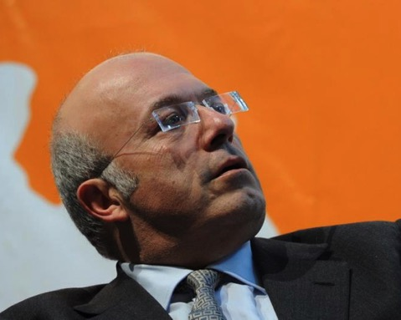
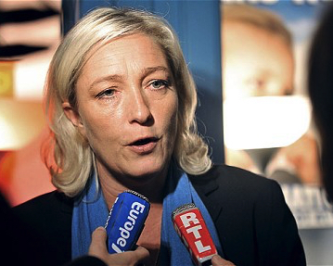
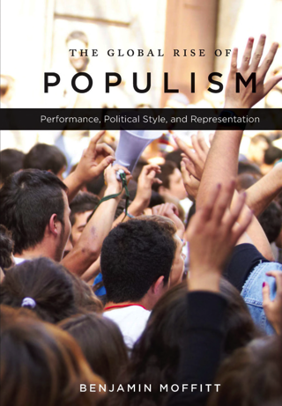
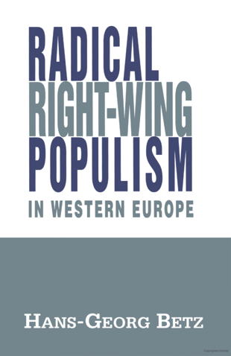
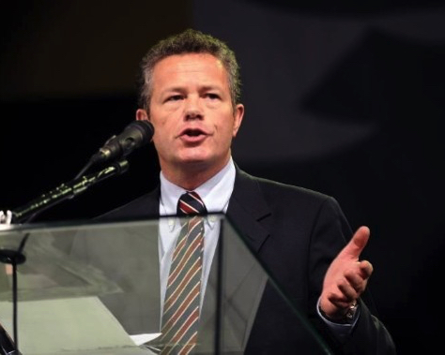
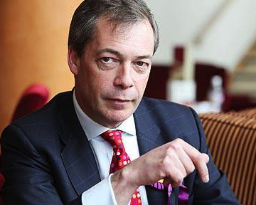
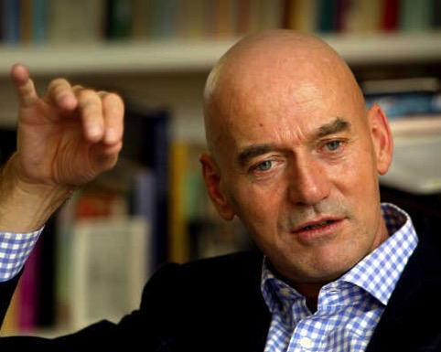
Populism in Europe
Notes:
Jörg Haider (FPO), Marine Le Pen (Front Nationale), Geert Wilders (Netherlands PVV), Pim Fortuyn (Netherlands LPF), Frank Vanhecke (Belgium Vlaams Blok), Nigel Farage (UK Independence Party), Francesco Storace (Italy, National Alliance)
Populism appears to be deeply intertwined with Euroskepticism, Islamophobia, nativitsm, etc. – for most radical right and populism are coterminous

Slide 3
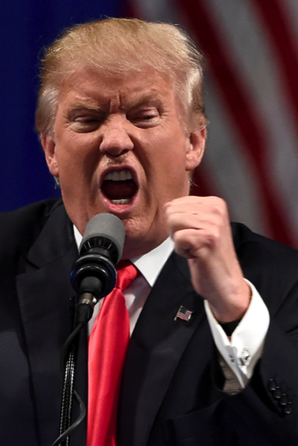
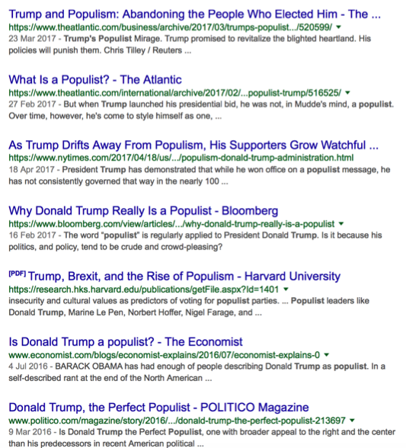
Populism in Europe … and the United States
Notes:
Jörg Haider (FPO), Marine Le Pen (Front Nationale), Geert Wilders (Netherlands PVV), Pim Fortuyn (Netherlands LPF), Frank Vanhecke (Belgium Vlaams Blok), Nigel Farage (UK Independence Party), Francesco Storace (Italy, National Alliance)
Populism appears to be deeply intertwined with Euroskepticism, Islamophobia, nativitsm, etc. – for most radical right and populism are coterminous

Slide 4
But is the radical right primarily populist?
And what do we mean by populism?
(Important: not simply conceptual nitpicking.)
Notes:
Hans-Georg Betz (of Swank & Betz)

Slide 5
Plan for today
Four goals
Address the conceptual confusion concerning the radical right (and to some extent, the radical left)
Consider trends in the cultural supply of and demand for the constitutive elements of radical politics
Suggest a structural-resonance-based explanation for the rise of radical politics
Discuss the potential risks to democracy and group relations associated with the rise of the radical right
Examples will focus on the US, but patterns also hold in Europe (with important differences, which I will mention)

Slide 6
Plan for today
Four goals
Address the conceptual confusion concerning the radical right (and to some extent, the radical left)
Consider trends in the cultural supply of and demand for the constitutive elements of radical politics
Suggest a structural-resonance-based explanation for the rise of radical politics
Discuss the potential risks to democracy and group relations associated with the rise of the radical right
Examples will focus on the US, but patterns also hold in Europe (with important differences, which I will mention)

Slide 7
Plan for today
Five conclusions
Populism is not the primary attribute of radical politics; authoritarianism and nationalism are (at least) as important
Populist and nationalist discourse is not new and people are not becoming more racist, xenophobic, anti-democratic, or anti-elite
What is changing is the resonance of populism, nationalism, and authoritarianism
Why? Cultural, economic, demographic, and security shocks → perceived threats to white majorities, exploited by political actors (sometimes experienced directly but often mediated)
Radical politics threaten democratic practice, social cohesion, and geopolitical stability (but how much varies across cases…)

Slide 8
Plan for today
Four goals
Address the conceptual confusion concerning the radical right (and to some extent, the radical left)
Consider trends in the cultural supply of and demand for the constitutive elements of radical politics
Suggest a structural-resonance-based explanation for the rise of radical politics
Discuss the potential risks to democracy and group relations associated with the rise of the radical right
Examples will focus on the US, but patterns also hold in Europe (with important differences, which I will mention)

Slide 9
What constitutes the radical right?
radical right
authoritarian
populist
illiberal
new right
far right
extreme right
nativist
anti-immigrant
neo-nationalist
Notes:
Hans-Georg Betz (of Swank & Betz)

Slide 10
What constitutes the radical right?
radical right
authoritarian
populist
illiberal
new right
Radical Right = Populism + Nationalism + Authoritarianism
far right
extreme right
nativist
anti-immigrant
neo-nationalist
Notes:
Hans-Georg Betz (of Swank & Betz)

Slide 11
What constitutes the radical right?
radical right
authoritarian
populist
illiberal
new right
Radical Right = Populism + Nationalism + Authoritarianism
far right
extreme right
nativist
anti-immigrant
neo-nationalist
Notes:
Hans-Georg Betz (of Swank & Betz)

Slide 12
What constitutes the radical right?
radical right
authoritarian
populist
illiberal
new right
Radical Right = Populism + Nationalism + Authoritarianism
far right
extreme right
nativist
anti-immigrant
neo-nationalist
Notes:
Hans-Georg Betz (of Swank & Betz)

Slide 13
Populism, Nationalism, and Authoritarianism
Why distinguish these three elements?
Need for analytical precision – conflation leads to poor understanding
Each has different causes and consequences
The three elements are not necessarily limited to the radical right (esp. true of populism and authoritarianism)
Makes it possible to differentiate between campaign and governance styles
Allows for closer consideration of supply of, demand for, and resonance of radical-right politics

Slide 14
Populism, Nationalism, and Authoritarianism
Why distinguish these three elements?
Need for analytical precision – conflation leads to poor understanding
Each has different causes and consequences
The three elements are not necessarily limited to the radical right (esp. true of populism and authoritarianism)
Makes it possible to differentiate between campaign and governance styles
Allows for closer consideration of supply of, demand for, and resonance of radical-right politics

Slide 15
Populism, Nationalism, and Authoritarianism
Precedent
Mudde (2007)
  Distinguishes populism from nationalism and authoritarianism
  But reduces nationalism to nativism
  Essentializes populism as an ideology
  Uses these concepts primarily to classify parties, not as phenomena worthy of their own study
  We need to theorize these three elements more carefully and treat them as sources of mechanisms that link popular grievances with party strategies

Slide 16
What constitutes the radical right?
radical right
authoritarian
populist
illiberal
new right
Radical Right = Populism + Nationalism + Authoritarianism
far right
extreme right
nativist
anti-immigrant
neo-nationalist
Notes:
Hans-Georg Betz (of Swank & Betz)

Slide 17
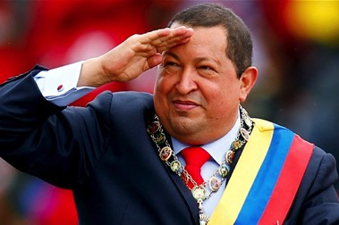
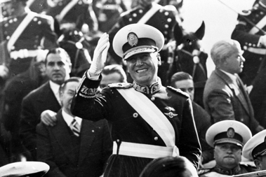
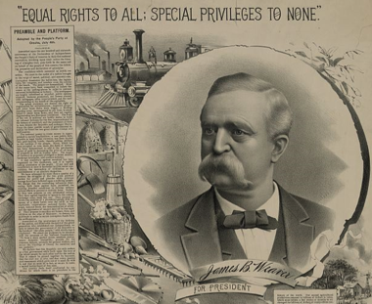
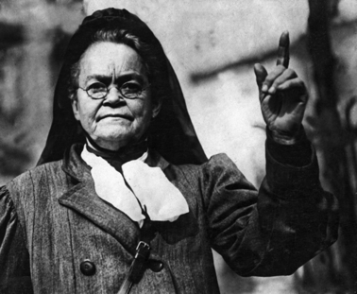
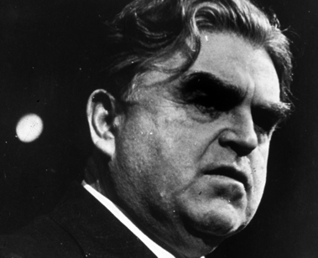
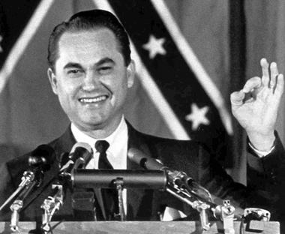
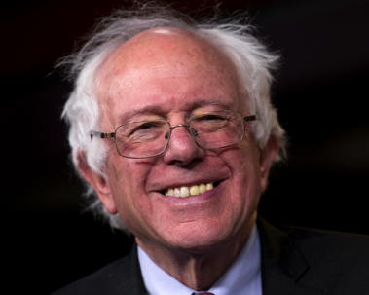
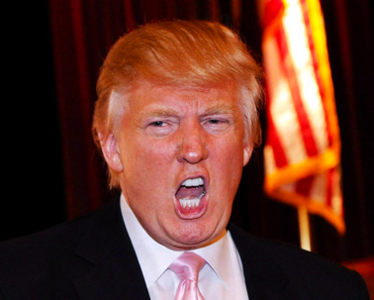
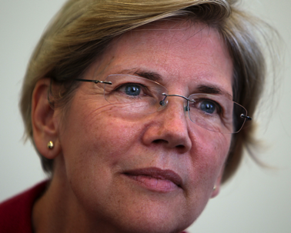
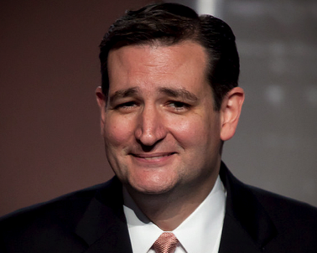
Populism: beyond the right, beyond ideology
Notes:
James Weaver (Populist Party) vs. Carrie Nation (temperance movement)
John Lewis (CIO) vs. George Wallace

Slide 18
Populism: beyond the right, beyond ideology
Consistent with existing theories
Laclau (2005)
“By populism we do not understand a type of movement – identifiable with a special social base or a particular ideological orientation – but a political logic […] involving a rarified system of statements”
Mudde and Kaltwasser (2012)
“In theory, populism is an independent ideology, unattached to any particular other ideology. In practice, populism is almost always combined with one or more ideological features. Which ideological features attach to populism depend upon the socio-political context within which the populist actors mobilize.”

Slide 19
Populism: beyond the right, beyond ideology
Populism conceptualized as:
Form of mobilization
Thin-centered ideology
Political discourse
Leadership + organization
Political
actors
Political
texts

Slide 20
Populism: beyond the right, beyond ideology
Form of political claims-making predicated on a fundamental moral opposition between a virtuous populace and corrupt elites (Mudde 2007). Such claims are based on a particular view of democratic representation, whereby the people—usually broadly construed—are the only legitimate source of political power and should therefore be engaged in political decision-making in as direct a fashion as possible. The people’s interests are viewed as incompatible with those of representative institutions and elite actors, who are perceived as having abandoned democratic principles in favor of the pursuit of their own self-interested ends.

Slide 21
Populism: beyond the right, beyond ideology
Form of political claims-making predicated on a fundamental moral opposition between a virtuous populace and corrupt elites (Mudde 2007). Such claims are based on a particular view of democratic representation, whereby the people—usually broadly construed—are the only legitimate source of political power and should therefore be engaged in political decision-making in as direct a fashion as possible. The people’s interests are viewed as incompatible with those of representative institutions and elite actors, who are perceived as having abandoned democratic principles in favor of the pursuit of their own self-interested ends.

Slide 22
Populism: beyond the right, beyond ideology
Form of political claims-making predicated on a fundamental moral opposition between a virtuous populace and corrupt elites (Mudde 2007). Such claims are based on a particular view of democratic representation, whereby the people—usually broadly construed—are the only legitimate source of political power and should therefore be engaged in political decision-making in as direct a fashion as possible. The people’s interests are viewed as incompatible with those of representative institutions and elite actors, who are perceived as having abandoned democratic principles in favor of the pursuit of their own self-interested ends.

Slide 23
Populism: beyond the right, beyond ideology
Form of political claims-making predicated on a fundamental moral opposition between a virtuous populace and corrupt elites (Mudde 2007). Such claims are based on a particular view of democratic representation, whereby the people—usually broadly construed—are the only legitimate source of political power and should therefore be engaged in political decision-making in as direct a fashion as possible. The people’s interests are viewed as incompatible with those of representative institutions and elite actors, who are perceived as having abandoned democratic principles in favor of the pursuit of their own self-interested ends.

Slide 24
Populism: beyond the right, beyond ideology
Form of political claims-making predicated on a fundamental moral opposition between a virtuous populace and corrupt elites (Mudde 2007). Such claims are based on a particular view of democratic representation, whereby the people—usually broadly construed—are the only legitimate source of political power and should therefore be engaged in political decision-making in as direct a fashion as possible. The people’s interests are viewed as incompatible with those of representative institutions and elite actors, who are perceived as having abandoned democratic principles in favor of the pursuit of their own self-interested ends.

Slide 25
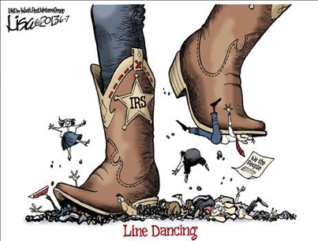
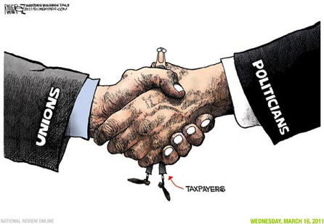
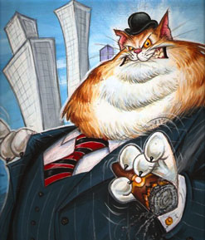
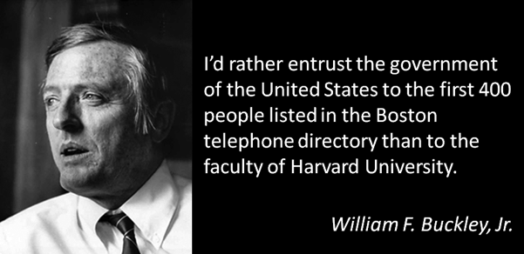
Populism: beyond the right, beyond ideology
Content of categories varies

Slide 26
Populism as discourse: analytical payoff
US presidential elections

Slide 27
Populism as discourse: analytical payoff
US presidential elections: content of populist claims

Slide 28
Populism as discourse: analytical payoff
US presidential elections: position in field

Slide 29
Populism as discourse: analytical payoff
US presidential elections: position in field

Slide 30
Populism as discourse: analytical payoff
US presidential elections: campaign dynamics

Slide 31
Populism as discourse: analytical payoff
European Parliament plenary debates

Slide 32
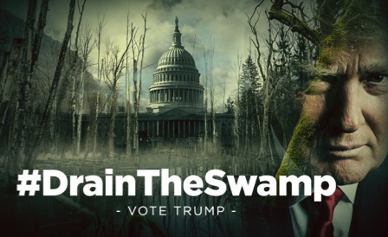
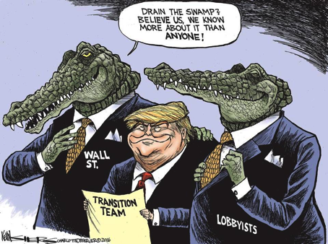
Populism as discourse: analytical payoff
The Trump case

Slide 33
Populism: beyond the right, beyond ideology
What are the implications?
Populism is not a deep ideological commitment on the part of elites and even less so on the part of voters
Populism is not a source of identity – but it can be used to activate other identities
Populism is a dynamic political strategy of outsiders, but outsider status is relative (both within mainstream and between mainstream and radical flanks) – by focusing on party classification we miss continuities in populist discourse
Populist frames are and have long been widespread in the US and Europe, but their effectiveness has varied (foreshadowing: due to context and variable coupling with other claims)

Slide 34
Populism: beyond the right, beyond ideology
What is missing?
1. Nativism, xenophobia, racism, anti-immigrant policies
2. Threats to democratic norms and institutions
These are not inherent attributes of populism, so we need additional concepts to capture them

Slide 35
What constitutes the radical right?
radical right
authoritarian
populist
illiberal
new right
Radical Right = Populism + Nationalism + Authoritarianism
far right
extreme right
nativist
anti-immigrant
neo-nationalist
Notes:
Hans-Georg Betz (of Swank & Betz)

Slide 36
What constitutes the radical right?
radical right
authoritarian
populist
illiberal
new right
Radical Right = Populism + Nationalism + Authoritarianism
far right
extreme right
nativist
anti-immigrant
neo-nationalist
Notes:
Hans-Georg Betz (of Swank & Betz)

Slide 37

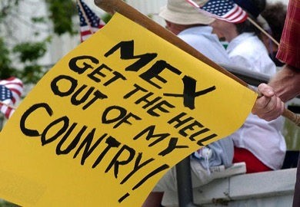

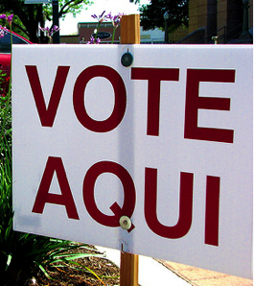

Nationalism: schemas of the nation
Notes:
Kitschelt

Slide 38

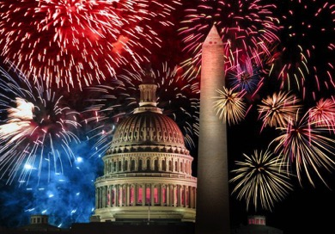

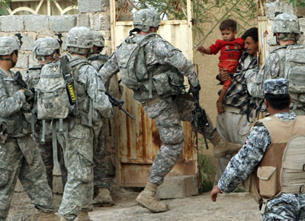
Nationalism: schemas of the nation
Notes:
Kitschelt

Slide 39
Nationalism: schemas of the nation
Beyond national character
Not just ideology, but shared understandings of the nation – cognitive frames that structure lived experience and are reflected in public discourse
Evidence of significant within-country fragmentation and between-country similarity
Long-term prominence of ethnocultural and anti-institutional varieties of popular nationalism in all Western democracies
Often uncorrelated with actual presence of “outsiders”
Notes:
Kitschelt

Slide 40
Nationalism: schemas of the nation
Ethno-nationalism
Exclusionary definition of symbolic boundaries of the nation
Mostly a radical-right issue, but left and right sometimes converge on Euroscepticism and nativism
Tension between inclusive citizenship regimes and widely shared exclusionary definitions of the nation
Generates visceral sense of grievance as affront to collective identity – not just racism (though that too) – inchoate frustration with multiculturalism, cosmopolitanism, and restrictive linguistic norms
Intertwined with class resentments
Notes:
Kitschelt

Slide 41
Nationalism: schemas of the nation
Beyond ethno-nationalism
Ethno-nationalism does not exhaust the content of nationalist beliefs: also pride in aspects of the nation and the state, beliefs about country’s place in the world (chauvinism)
These cohere into four robust schemas observed across countries and time: liberal, restrictive, ardent, and disengaged
Notes:
Kitschelt

Slide 42
Nationalism: schemas of the nation
Beyond ethno-nationalism
Ethno-nationalism does not exhaust the content of nationalist beliefs: also pride in aspects of the nation and the state, beliefs about country’s place in the world (chauvinism)
These cohere into four robust schemas observed across countries and time: liberal, restrictive, ardent, and disengaged
Notes:
Kitschelt

Slide 43
Nationalism: schemas of the nation
Beyond ethno-nationalism
Ethno-nationalism does not exhaust the content of nationalist beliefs: also pride in aspects of the nation and the state, beliefs about country’s place in the world (chauvinism)
These cohere into four robust schemas observed across countries and time: liberal, restrictive, ardent, and disengaged
Patterned, stable, correlated with sociodemographic attributes, and rooted in everyday experience → latent cleavages that can be activated and mobilized for political ends
Notes:
Kitschelt

Slide 44
Nationalism: schemas of the nation
Beyond ethno-nationalism
Ethno-nationalism does not exhaust the content of nationalist beliefs: also pride in aspects of the nation and the state, beliefs about country’s place in the world (chauvinism)
These cohere into four robust schemas observed across countries and time: liberal, restrictive, ardent, and disengaged
Patterned, stable, correlated with sociodemographic attributes, and rooted in everyday experience → latent cleavages that can be activated and mobilized for political ends
Importantly: cut across ideology, party id, and race
Often invoked in politics: Trump vs. Clinton vs. Sanders
Notes:
Kitschelt

Slide 45
Nationalism: schemas of the nation
Change over time

Slide 46
Nationalism: schemas of the nation
What are the implications?
Unlike populism, nationalism is a deep cultural commitment – for both elites and voters (often latent not manifest at the individual level)
Unlike populism, nationalism is a crucial source of identity – powerful collective logic with extensive cultural and institutional legitimacy
Nationalist cleavages are present in every country, but not always politically salient
Salience requires right structural conditions accompanied by right discursive mix (more on this later) -- often against backdrop of eroding/threatened competing identities

Slide 47
What constitutes the radical right?
radical right
authoritarian
populist
illiberal
new right
Radical Right = Populism + Nationalism + Authoritarianism
far right
extreme right
nativist
anti-immigrant
neo-nationalist
Notes:
Hans-Georg Betz (of Swank & Betz)

Slide 48
What constitutes the radical right?
radical right
authoritarian
populist
illiberal
new right
Radical Right = Populism + Nationalism + Authoritarianism
far right
extreme right
nativist
anti-immigrant
neo-nationalist
Notes:
Hans-Georg Betz (of Swank & Betz)

Slide 49
Authoritarianism: how the radical right governs
Anti-democratic governance practices
Tendency toward violation of democratic norms and circumvention of established institutions in the interest of maintaining power
Anti-pluralist conceptualization of popular will represented by strong leader
Particular techniques of governance: colonization of the state, mass clientelism, discriminatory legalism (Weyland, Müller)
→ delegitimization of opposition, persecution of civil society, threats to judicial and media autonomy, unfair elections
Repertoire has diffused across countries
Notes:
Kitschelt

Slide 50
Authoritarianism: how the radical right governs
What are the implications?
Authoritarianism is rarely articulated as an ideology – more typically, a set of governance practices and a collection of diffuse beliefs about appropriate institutional norms
Like populism, it is rarely a source of identity, but it can be justified by anti-elite moral appeals and the vilification of “outsiders”
Politically (as opposed to socially), it is the most dangerous of the three elements of radicalism – can lead directly to the erosion of democratic institutions (when guardrails of democracy fail)

Slide 51
What constitutes the radical right?
radical right
authoritarian
populist
illiberal
new right
Radical Right = Populism + Nationalism + Authoritarianism
far right
extreme right
nativist
anti-immigrant
neo-nationalist
Distinct components, but with points of articulation
Notes:
Hans-Georg Betz (of Swank & Betz)

Slide 52
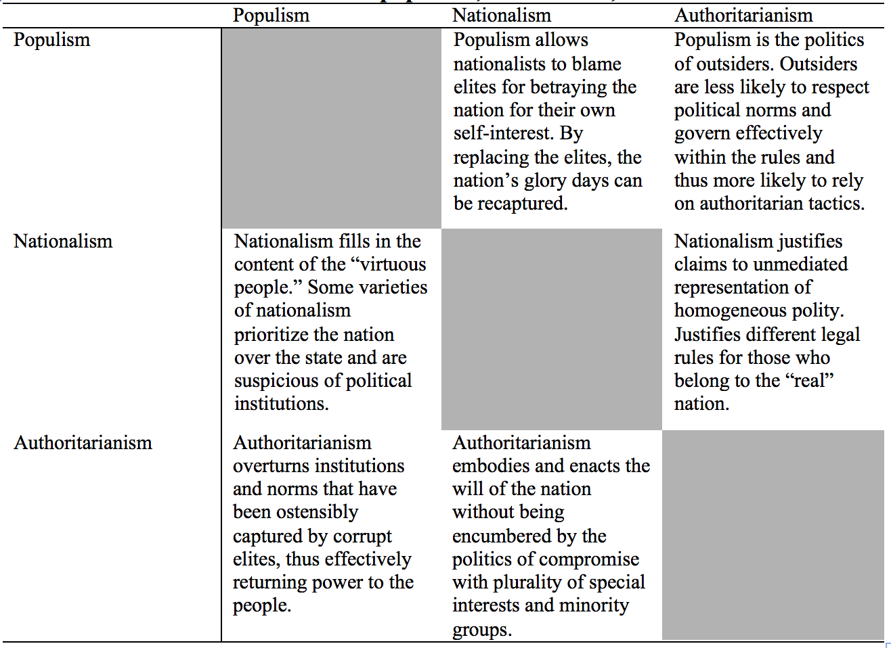
Points of articulation between three elements

Slide 53
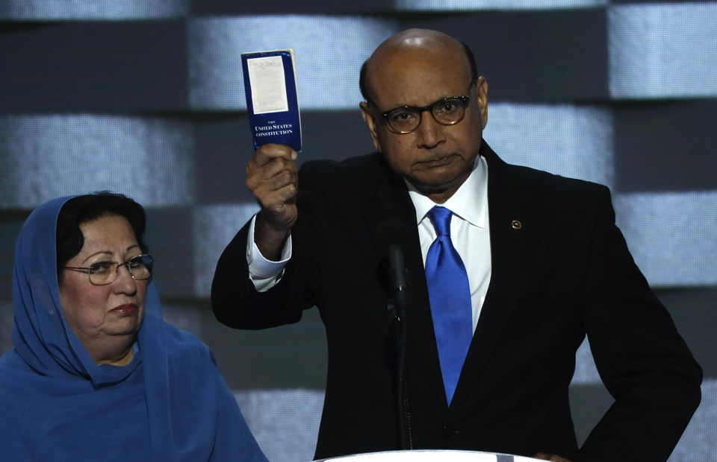
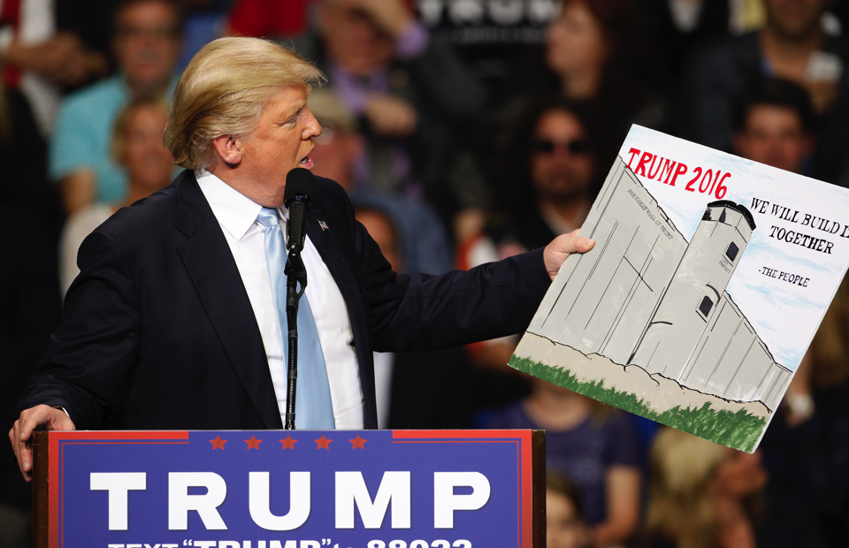
Some examples: Trump’s nationalism

Slide 54
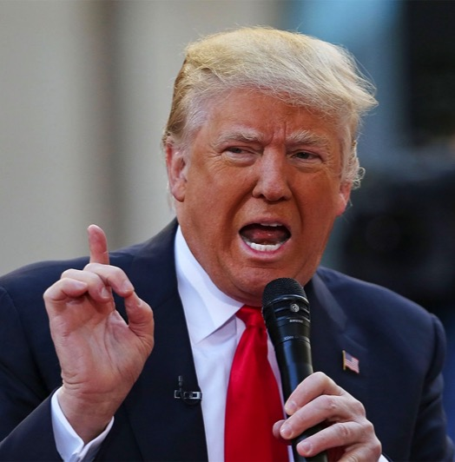
Some examples: Trump’s nationalism
“When Mexico sends its people, they’re not sending their best. They’re not sending you. They’re not sending you. They’re sending people that have lots of problems […]. They’re bringing drugs. They’re bringing crime. They’re rapists. And some, I assume, are good people.” DJT, 6/16/15

Slide 55
Some examples: Trump’s nationalism
“From this day forward, it's going to be only America first, America first. […] We must protect our borders from the ravages of other countries making our product, stealing our companies and destroying our jobs.” DJT 1/20/17

Slide 56
Some examples: Trump’s nationalism
“At the bedrock of our politics will be a total allegiance to the United States of America, and through our loyalty to the country, we will rediscover our loyalty to each other. When you open your heart to patriotism, there is no room for prejudice.” DJT 1/20/17

Slide 57
Some examples: Trump’s nationalism
“You have some very bad people in that group, but you also had people that were very fine people on both sides. You had people in that group — excuse me, excuse me — I saw the same pictures as you did.” DJT 8/15/17

Slide 58
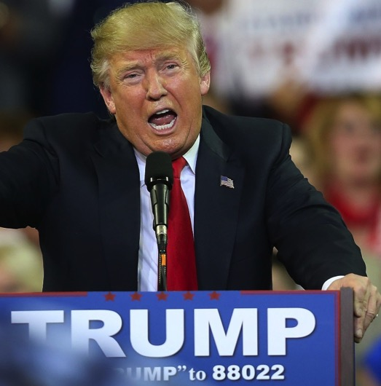
Some examples: Trump’s populism
“Come November, the American people will have the chance to re-declare their independence. Americans will have a chance to vote for trade, immigration and foreign policies that put our citizens first. They will have the chance to reject today's rule by the global elite, and to embrace real change that delivers a government of, by and for the people.” DJT 6/24/16

Slide 59
Some examples: Trump’s populism
“What truly matters is not which party controls our government, but whether our government is controlled by the people. January 20th 2017, will be remembered as the day the people became the rulers of this nation again.” DJT 1/20/17

Slide 60
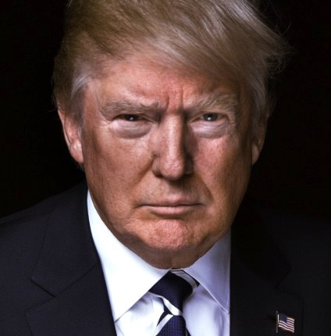
Some examples: Trump’s authoritarianism
“Courts seem to be so political and it would be so great for our justice system if they would be able to read a statement and do what's right," he said. "And that has to do with the security of our country.” DJT 2/7/17

Slide 61
Some examples: Trump’s authoritarianism
“We’re not allowed to punch back anymore. I love the old days. You know what they used to do to guys like that? When they were in a place like this? They’d be carried out on a stretcher, folks.” DJT 2/22/16

Slide 62
Some examples: Trump’s authoritarianism
“The FAKE NEWS media (failing @nytimes, @CNN, @NBCNews and many more) is not my enemy, it is the enemy of the American people. SICK!.” DJT 2/17/17

Slide 63
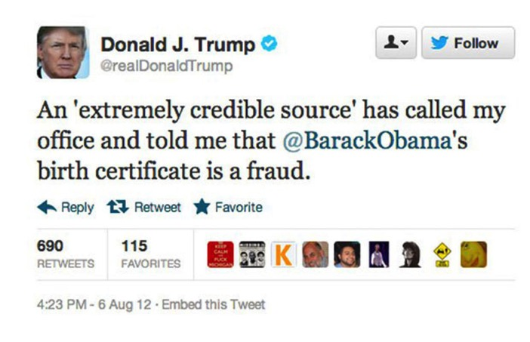
Some examples: Trump’s golden ticket

Slide 64
How do the three elements operate together?
Discourse / strategy
Centrality of organizational learning and ecological diffusion: after initial innovation, elements are tried out (in various combinations) and when they work, they stick
Once effective, they diffuse, and in the process of adoption, they are adapted to local context
Beliefs
Nationalist cleavages are the fuel, anti-elitism and low institutional trust direct the fire, tolerance for authoritarian rule is the consequence – but all three vary more in salience than prevalence (relative favorability of structural context as catalyst)
Notes:
Kitschelt

Slide 65
What about the radical left?
Some similarities, one big difference
Populism a key feature
Authoritarianism less obvious, but sometimes present
Ethno-nationalism generally muted (with some exceptions)
Instead, reliance on economic nationalism
The main cleavage is not between understandings of the nation, but between economic classes – not about recognition but about redistribution
Notes:
Kitschelt

Slide 66
Plan for today
Four goals
Address the conceptual confusion concerning the radical right (and to some extent, the radical left)
Consider trends in the cultural supply of and demand for the constitutive elements of radical politics
Suggest a structural-resonance-based explanation for the rise of radical politics
Discuss the potential risks to democracy and group relations associated with the rise of the radical right
Examples will focus on the US, but patterns also hold in Europe (with important differences, which I will mention)

Slide 67
Plan for today
Four goals
Address the conceptual confusion concerning the radical right (and to some extent, the radical left)
Consider trends in the cultural supply of and demand for the constitutive elements of radical politics
Suggest a structural-resonance-based explanation for the rise of radical politics
Discuss the potential risks to democracy and group relations associated with the rise of the radical right
Examples will focus on the US, but patterns also hold in Europe (with important differences, which I will mention)

Slide 68
Radical-right politics: why now?
Supply and demand trends
Demand side: have U.S. and European politicians come to rely on populism, nationalism, and authoritarianism more frequently?
Supply side: have proximate attitudes connected to these three elements increased in prevalence in European countries and Europe?

Slide 69
Radical-right politics: why now?
Four possible scenarios
 |  | Supply (i.e., elite discourse)
 |  | Stable | Increasing
Demand (i.e., popular attitudes) | Stable | No change. Cannot account for changing outcomes without another intervening factor (i.e., contextual shifts in resonance). | Pre-existing demand is met by new entrants into political field or discursive shifts among existing political parties.
 | Increasing | Changes in attitudes lead to alignment of public with pre-existing political claims. | Fringe politics become mainstream, as both supply and demand increase.
Notes:
Kitschelt

Slide 70
Radical-right politics: why now?
Four possible scenarios
 |  | Supply (i.e., elite discourse)
 |  | Stable | Increasing
Demand (i.e., popular attitudes) | Stable | No change. Cannot account for changing outcomes without another intervening factor (i.e., contextual shifts in resonance). | Pre-existing demand is met by new entrants into political field or discursive shifts among existing political parties.
 | Increasing | Changes in attitudes lead to alignment of public with pre-existing political claims. | Fringe politics become mainstream, as both supply and demand increase.
Notes:
Kitschelt

Slide 71
Radical-right politics: why now?
Four possible scenarios
 |  | Supply (i.e., elite discourse)
 |  | Stable | Increasing
Demand (i.e., popular attitudes) | Stable | No change. Cannot account for changing outcomes without another intervening factor (i.e., contextual shifts in resonance). | Pre-existing demand is met by new entrants into political field or discursive shifts among existing political parties.
 | Increasing | Changes in attitudes lead to alignment of public with pre-existing political claims. | Fringe politics become mainstream, as both supply and demand increase.
Notes:
Kitschelt

Slide 72
Radical-right politics: why now?
Four possible scenarios
 |  | Supply (i.e., elite discourse)
 |  | Stable | Increasing
Demand (i.e., popular attitudes) | Stable | No change. Cannot account for changing outcomes without another intervening factor (i.e., contextual shifts in resonance). | Pre-existing demand is met by new entrants into political field or discursive shifts among existing political parties.
 | Increasing | Changes in attitudes lead to alignment of public with pre-existing political claims. | Fringe politics become mainstream, as both supply and demand increase.
Notes:
Kitschelt

Slide 73
Radical-right politics: why now?
Four possible scenarios
 |  | Supply (i.e., elite discourse)
 |  | Stable | Increasing
Demand (i.e., popular attitudes) | Stable | No change. Cannot account for changing outcomes without another intervening factor (i.e., contextual shifts in resonance). | Pre-existing demand is met by new entrants into political field or discursive shifts among existing political parties.
 | Increasing | Changes in attitudes lead to alignment of public with pre-existing political claims. | Fringe politics become mainstream, as both supply and demand increase.
Notes:
Kitschelt

Slide 74
Radical-right politics: why now?
Supply side
Populism as widely available strategy on both right and left
  Evidence from my research with Noam Gidron on U.S. presidential elections and European Parliament plenary debates + historical evidence (Kazin, Mudde, Kitschelt)
Nationalism has a long history in U.S. and Europe
    Competing models of the nation (R. Smith), multiple waves of ethno-nationalism (Southern Strategy, English-only, Buchanan, etc.)
Authoritarianism more difficult to observe when not in power
  Nonetheless, recurrent theme in U.S. politics (McCarthy, Nixon, GOP in recent years) and part of European radical right since 1970s
  But, discursive mix has further diffused in recent decades

Slide 75
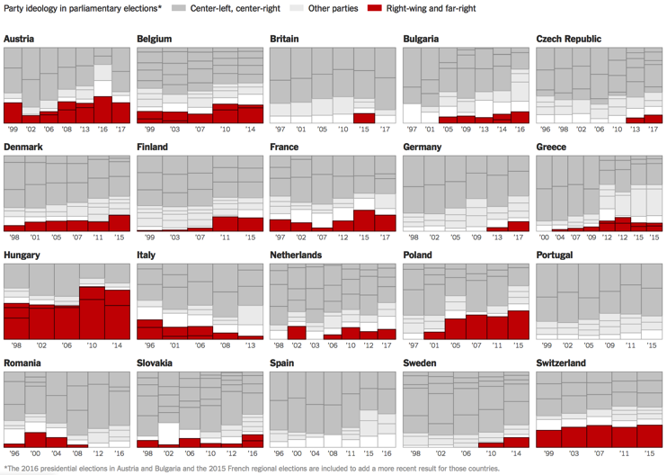
Radical-right politics: why now?
Supply side

Slide 76
Radical-right politics: why now?
Demand side
Populism: mistrust of elites, experts, and institutions
  Evidence mixed: downward trends in trust in the EU and the US government; trust in European national governments varies across countries (creditor vs. debtor) – but problems with this explanation
Nationalism: symbolic boundaries, pride, chauvinism
    Stability in content and distribution of nationalist cleavages, no increase in anti-immigrant sentiments
Authoritarianism: rejection of democracy (+ personality trait)
  Little systematic evidence for secular increase (except UK, Foa and Mounk’s comparative study widely criticized)

Slide 77
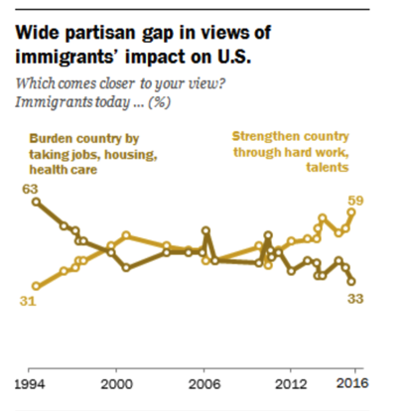
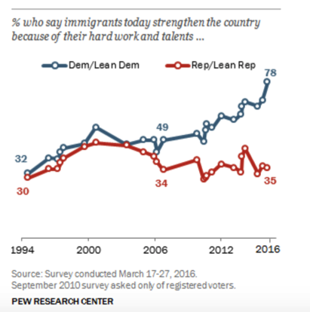
Radical-right politics: why now?
Notes:
http://www.pewresearch.org/fact-tank/2016/04/15/americans-views-of-immigrants-marked-by-widening-partisan-generational-divides/

Slide 78
Radical-right politics: why now?
Relative prevalence of four national schemas over time (U.S., 1996-2012)

Slide 79
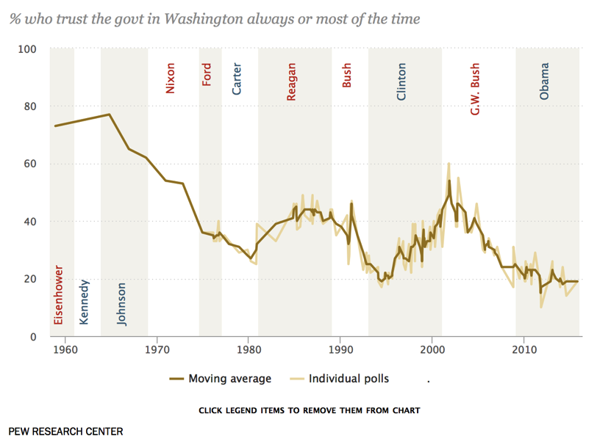
Radical-right politics: why now?
Notes:
http://www.people-press.org/2015/11/23/public-trust-in-government-1958-2015/

Slide 80
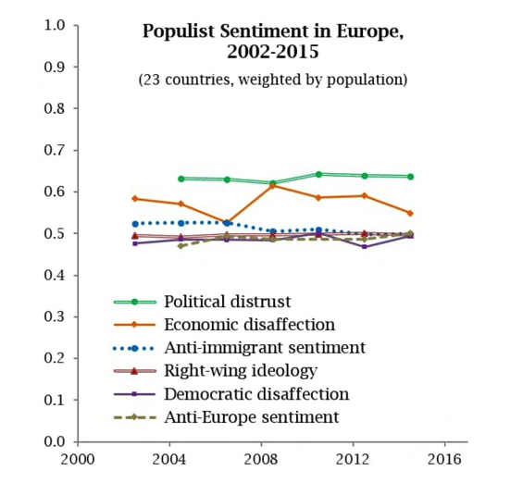
Radical-right politics: why now?
Attitudinal trends in Europe (Larry Bartels)

Slide 81
Radical-right politics: why now?
Four possible scenarios
 |  | Supply (i.e., elite discourse)
 |  | Stable | Increasing
Demand (i.e., popular attitudes) | Stable | No change. Cannot account for changing outcomes without another intervening factor (i.e., contextual shifts in resonance). | Pre-existing demand is met by new entrants into political field or discursive shifts among existing political parties.
 | Increasing | Changes in attitudes lead to alignment of public with pre-existing political claims. | Fringe politics become mainstream, as both supply and demand increase.
Notes:
Kitschelt

Slide 82
Radical-right politics: why now?
Toward a resonance-based perspective
Resonance is not only about a match between discursive frames and popular beliefs, but also about context: mobilization of pre-existing attitudes by pre-existing discourse under new conditions
Anxieties and grievances stemming from structural forces and exogenous shocks – experienced directly but also mediated
Sociotropic concerns: perceived affronts to group identity – life chances, dignity, moral commitments
Fears channeled by politicians and media into resentments toward elites and ethnic, racial, and religious out-groups
Notes:
Kitschelt

Slide 83
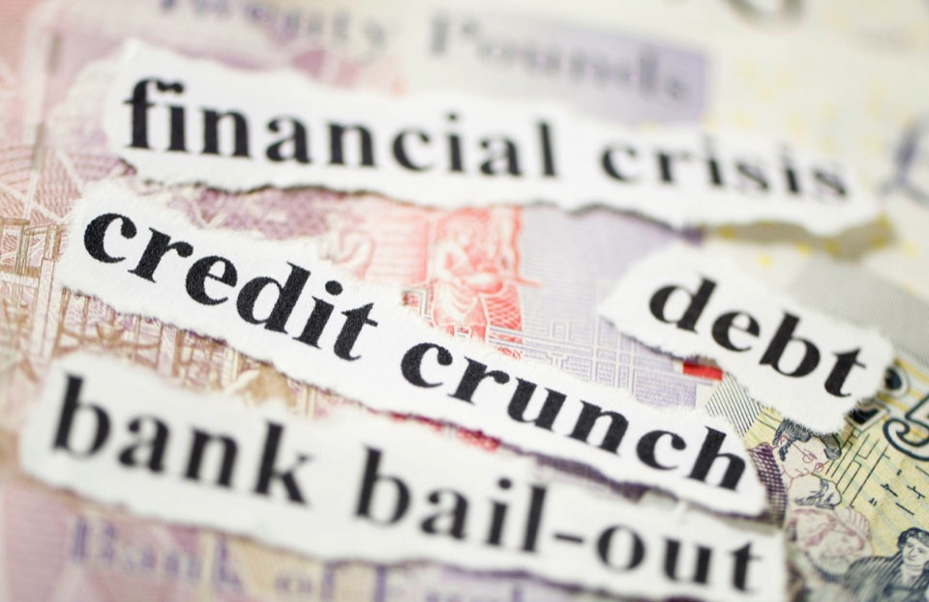
Radical-right politics: why now?
Notes:
Kitschelt

Slide 84

Radical-right politics: why now?
Notes:
Kitschelt

Slide 85

Radical-right politics: why now?
Notes:
Kitschelt

Slide 86

Radical-right politics: why now?
Notes:
Kitschelt

Slide 87

Radical-right politics: why now?
Notes:
Kitschelt

Slide 88

Radical-right politics: why now?
Notes:
Kitschelt

Slide 89
Radical-right politics: why now?
Toward a resonance-based perspective
Which shocks matter most? Need for multi-causal account
Economic: neo-liberalism (welfare state retrenchment, manufacturing collapse, free trade, capital mobility, union decline) → stark inequalities, economic crises
Demographic: immigration, racial resentment, terrorism → exploited by media, politicians, fringe organizations
Cultural: sense of exclusion from mainstream culture, loss of recognition → nostalgia for “simpler” times
Cohere into sense of collective status threat, often mediated by perceptions of (un)fairness
Notes:
Kitschelt

Slide 90
Radical-right politics: why now?
Toward a resonance-based perspective
These are seen as urgent problems in need of political solutions – but solutions are not forthcoming (elite normative commitments + political failures = political opportunity)
Latent ethno-nationalism in the population
+ erosion of old identities and perceptions of status threat
+ crises generating political and discursive opportunities
+ frustration with unresponsive/delegitimized party politics
salience of anti-system AND nationalist political cues
diffusion of political strategy across place
Country-specific factors shape timing and content
Notes:
Kitschelt

Slide 91
Plan for today
Four goals
Address the conceptual confusion concerning the radical right (and to some extent, the radical left)
Consider trends in the cultural supply of and demand for the constitutive elements of radical politics
Suggest a structural-resonance-based explanation for the rise of radical politics
Discuss the potential risks to democracy and group relations associated with the rise of the radical right
Examples will focus on the US, but patterns also hold in Europe (with important differences, which I will mention)

Slide 92
Plan for today
Four goals
Address the conceptual confusion concerning the radical right (and to some extent, the radical left)
Consider trends in the cultural supply of and demand for the constitutive elements of radical politics
Suggest a structural-resonance-based explanation for the rise of radical politics
Discuss the potential risks to democracy and group relations associated with the rise of the radical right
Examples will focus on the US, but patterns also hold in Europe (with important differences, which I will mention)

Slide 93
What’s next?
Democracy in peril?
Risk of crisis for liberal democracy – how it works out depends on strength of institutions (E. Europe vs. U.S.)
Two (related) dangers: gradual transition to competitive authoritarianism; geopolitical instability
Threats to judicial autonomy, media independence, constitutional continuity, peaceful transitions of power (“mutual toleration”), civil liberties, “procedural forbearance”
Fuelled by intense polarization and delegitimization of existing institutions and parties
Three illustrative cases: Turkey, Hungary, Poland (…US?)
Notes:
Kitschelt

Slide 94
What’s next?
Democracy in peril?
In the U.S., many danger signs:
  Mutual toleration and procedural forbearance: threats to persecute Clinton, firing of Comey, possibility of Mueller’s dismissal, but also blocking of Obama’s SC nominee, stacking of federal courts, etc.
  Threats to democracy itself: possible disregard for election results, verbal attacks on journalists, “fake news,” delegitimization of protesters, attempts to undermine courts and law enforcement
  Discriminatory legalism: border wall, travel bans, crackdown on affirmative action, defunding of Civil Rights Division, repeal of DACA, deportations of undocumented migrants
  All of this embraced by the Republican Party (and often championed by it) – challenges legitimacy of institutions, reinforces cleavages
Notes:
Kitschelt

Slide 95
What’s next?
Democracy in peril?
Importantly, net of political transformations, discourse itself has important consequences for group relations – harassment and violence
Moreover, activation of nationalist cleavages and anti-democratic sentiments creates conditions of future success for radical politics – potential for endogenous process
All of this suggests radical politics are here to stay
Whether democracy remains unscathed depends on commitment to institutional norms, especially by center-right parties, and on the magnitude of potential security crises (Mounk’s three scenarios)
Notes:
Kitschelt

Slide 96
Takeaway: to understand what’s driving radical politics, we must take populism, nationalism, and authoritarianism seriously, not as sources of definitional problems but as analytically meaningful categories in their own right
Notes:
Kitschelt

Slide 97

Thank you!

